Slide 1

The tools
Topic 2 – Mobile App Development
David Corsar Module Coordinator
d.corsar1@rgu.ac.uk

Slide 2
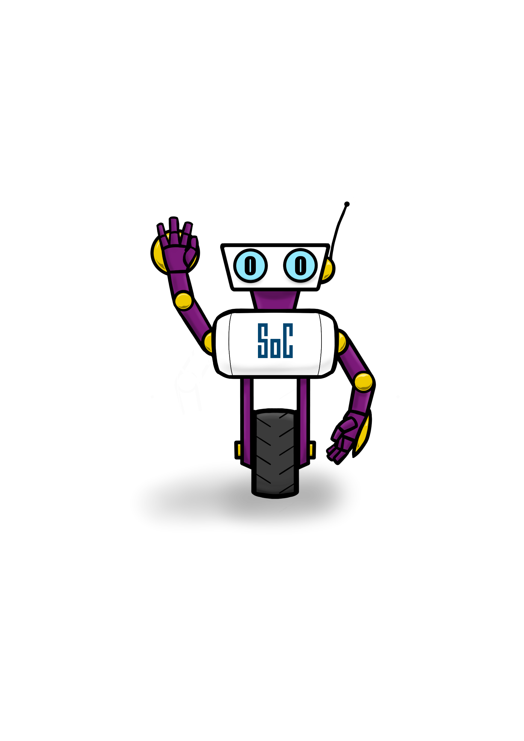
Which devices and tools have you used to develop and test software?
rgu.ac.uk/computing

Slide 3
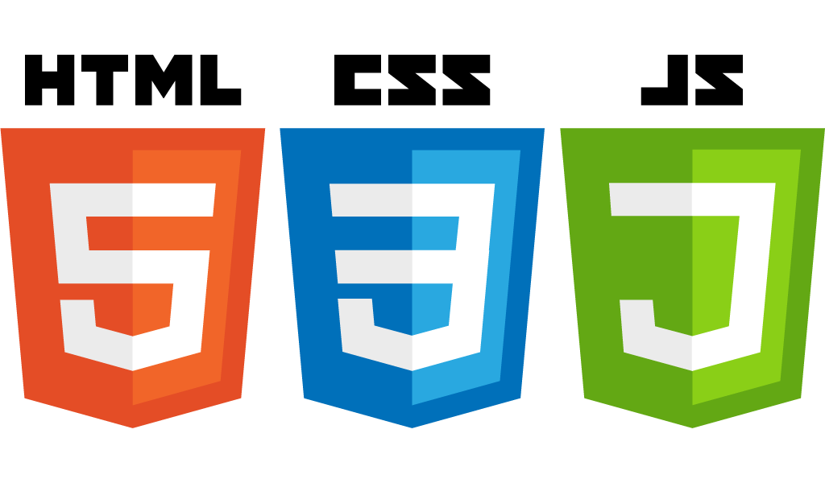

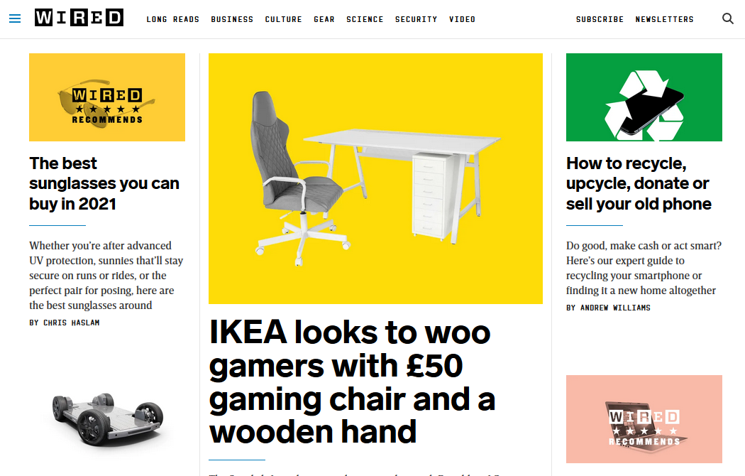
How webpages work (very roughly)
Content, forms, images, etc
Browser processes them all to produce
Style, layout
Interactivity

Slide 4

How Android UIs work (iOS is very similar)
strings XML
Text (i.e. context)
Android Runtime processes all these to display
Layout XML
Widgets, layout
colours XML
YOUR APP HERE
Styling
Java code
themes XML
Interactivity
Notes:
https://en.wikipedia.org/wiki/File:Android_logo_2019_(stacked).svg

Slide 5
So, its all XML and some coding then?
Yes
HTML and CSS was bad enough! Don’t fancy using XML to define each page of my app!!!!
Don’t worry about that

Slide 6
Android Studio
Integrated tool for building Android apps, based on InteliJ
Includes Java editor, drag and drop UI editor, debugger, testing, virtual device management
And various wizards
Downloadable from https://developer.android.com/studio

Slide 7
Android Studio and Project Files

Slide 8
Android Studio
Android Studio provides various tools to support app development.
We’ll use some of these
Code editor, UI builder, git integration, debugger, SDK Manager, AVD Manager, logcat, database inspector,…
Lets take a look at the first of these.

Slide 9
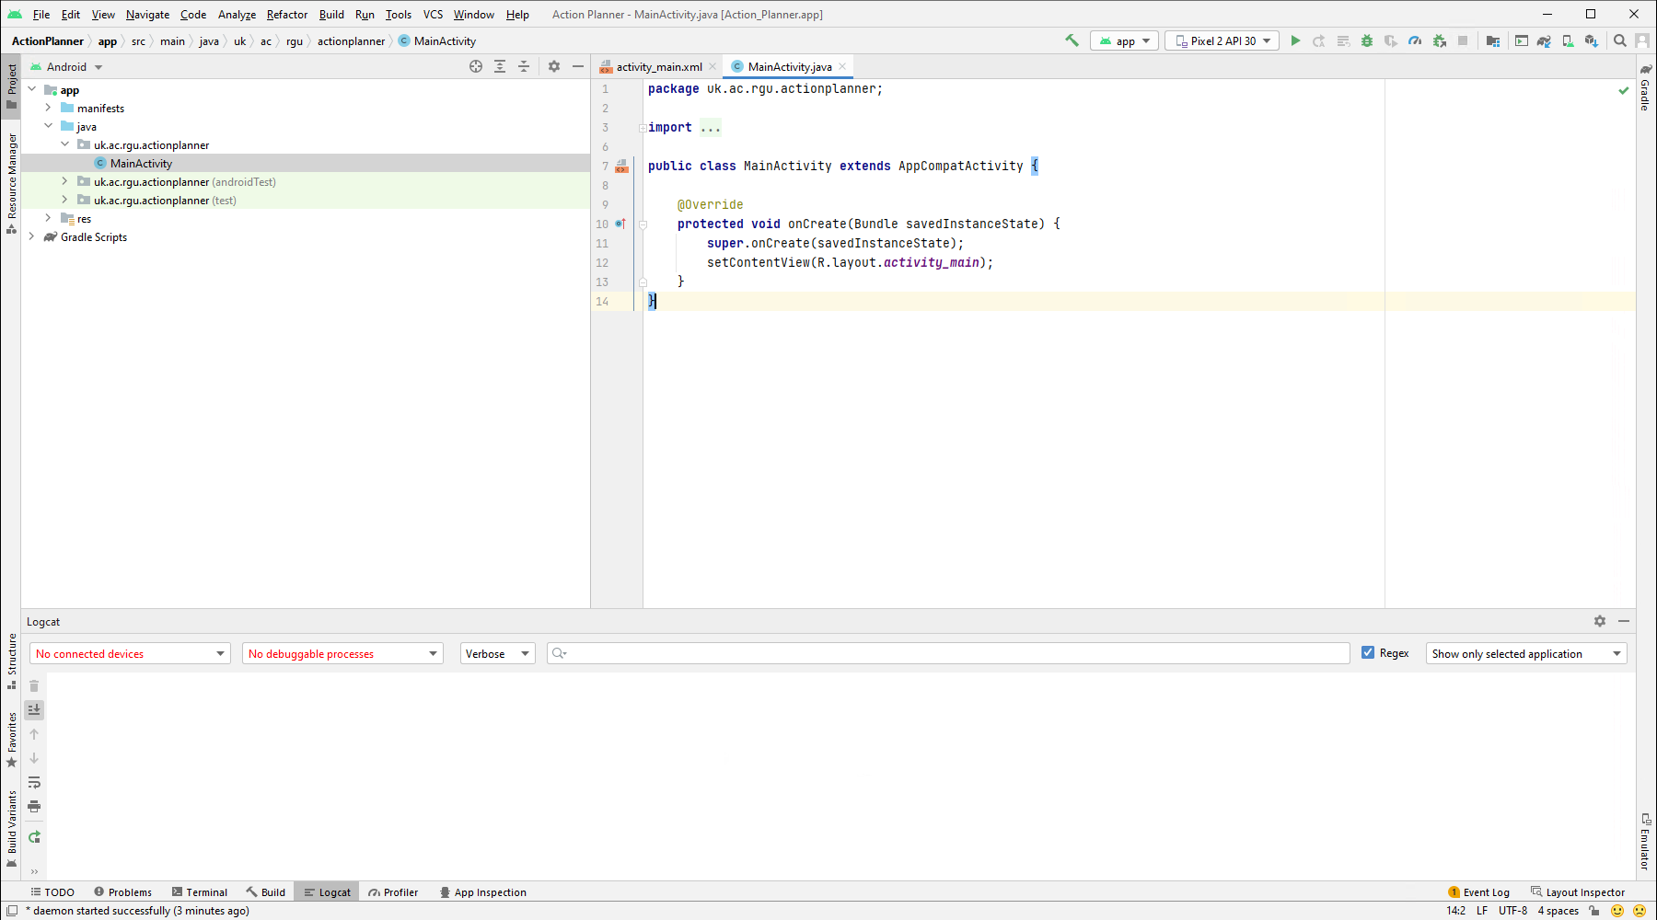
This area is our main development part, where we’ll edit files (text, Java, etc.) and edit our UIs
This area shows all of the files in our project
This area has various useful tools, displayed by clicking on the tabs at the bottom. Logcat is where any output from your app during runtime will be displayed

Slide 10
Project Files
Regardless of how your creating your app (Android native, or generic frameworks like Cordova, Xamerin, Unity) they all use the same types of files.
There are a lot of files, which can appear overwhelming.
many of these are generated and we never touch.
There are a few that we do concern ourselves with.

Slide 11
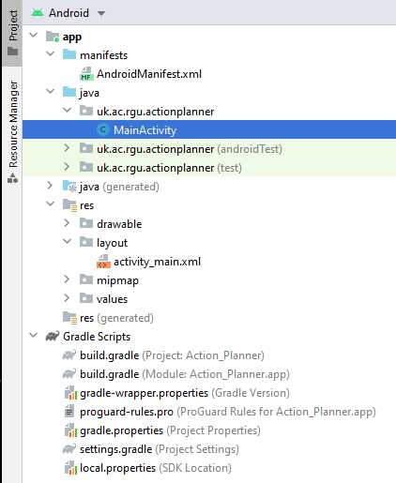
Project structure
Manifest file
Gradle build & other files. (We’ll deal with these later in the module)

Slide 12
The manifest file
Every app has one, we’ll edit it as necessary.
Provides core information about the app to the build tools, Android OS, and Google Play store, including:
Package name to provide the location of the project’s code.
App components.
Permissions.
Required hardware and software features.
More info on the Android Docs

Slide 13
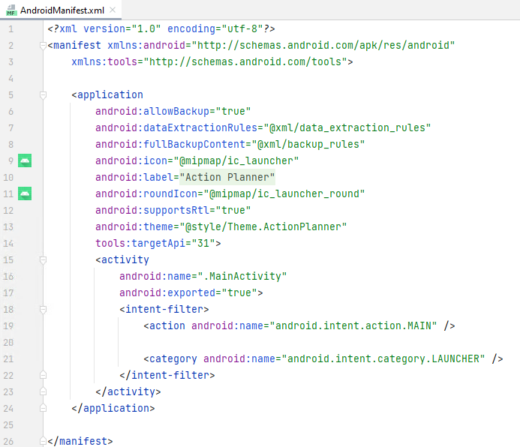
Sample manifest
Details about the app, including label for user’s launch screen.
We have one activity (MainActivity).
This tells Android OS to launch this MainActivity when opening the app

Slide 14
Starting app dev

Slide 15

Reminder: Todo app
Indicates task includes the target task
Create Task
<<service>> Device database
View a task
View all Tasks
Edit Task
Sync datastores
Delete Task
User
Add to Calendar
Cloud database Provider
Do a task
<<service>> Calendar app

Slide 16
Modelling the todo domain
What things are relevant to a todo app?
How would we describe these?

Slide 17
Modelling a task
How would we describe a thing that needs doing?
Name
Attributes
Type

Slide 18
Some of your suggestions during the lecture

Slide 19
Java domain objects
Domain model pattern that “provides object-oriented way of handling complicated logic by splitting business logic into multiple objects, each handling only the domain logic relevant to it”. (Java Design Patterns).
Useful to put these in a Java package called data, to group all data / domain logic classes together
Notes:
https://java-design-patterns.com/patterns/domain-model/

Slide 20
Project structure
All java files Java classes implementing the app JUnit tests for the UI JUnit tests for other Java code

Slide 21
Task domain object
We will use the Task class (extract shown to the right) to represent the Task domain model.
These are some attributes that may be used by Task related logic in our app – there can be others.
public class Task { private String name; private int pomodorosRemaining; private Date deadline; }
Extract from Task.java

Slide 22
More details of the Task class
public class Task { private String name; public Task(String name){
this.name = name; } public String getName(){
return this.name; } public void setName(String name){
return this.name = name; }
We define a class called Task
With a member variable called name, of type String, and only accessible within this class.
A constructor, so when a new Task is created the name is initialised via a parameter. Getter and setter methods so that other classes can get and set the task name.

Slide 23
Android Resources

Slide 24
Project structure
XML files defining UI layouts XML files defining various other resources – strings, colours

Slide 25
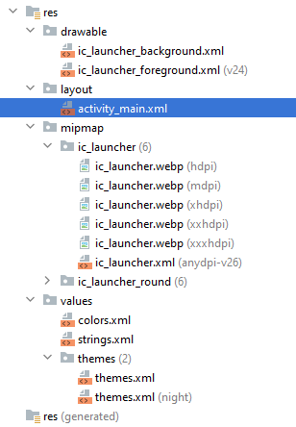
Resources
In Android almost everything is a resource.
Each type of resource is stored in its own subdirectory of res.
drawable (vector graphics), layout (UI), menu, values.
See Codepath’s excellent summary.

Slide 26
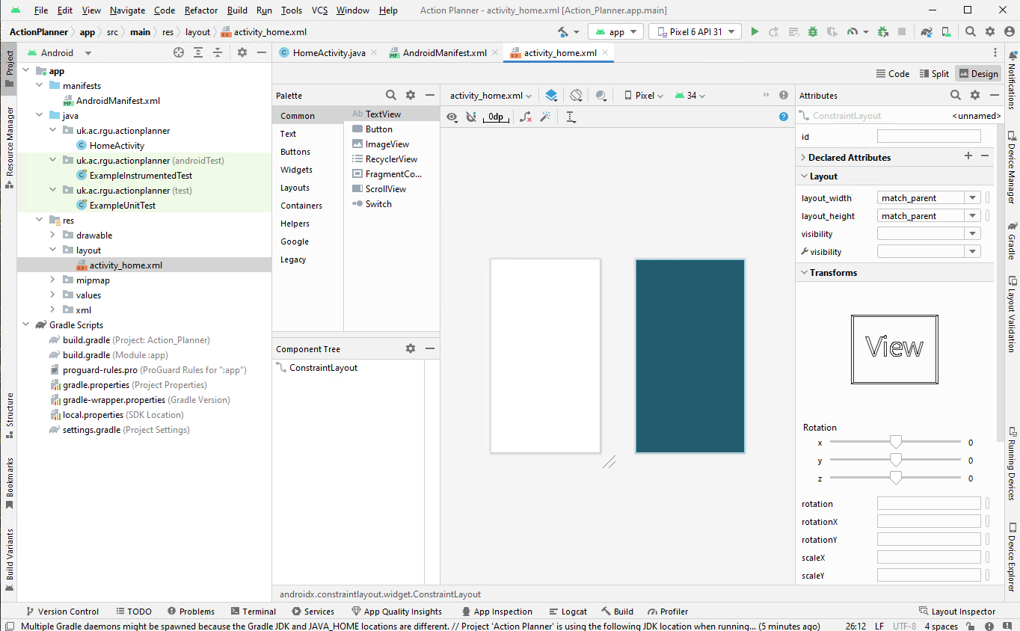
Double clicking on any layout XML file (usually in res/layout dir) displays the UI builder

Slide 27
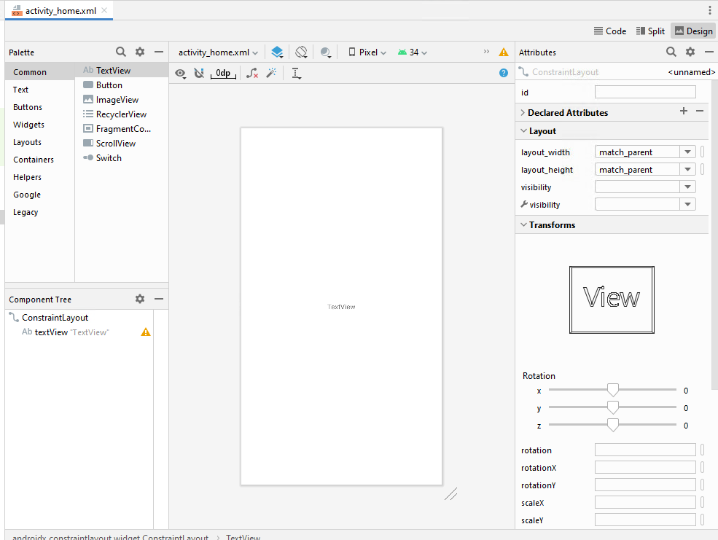
The basic app
Lets look at the simple empty Activity created by the Wiazrd.
Its empty.
So I’ve added a TextView (label)

Slide 28
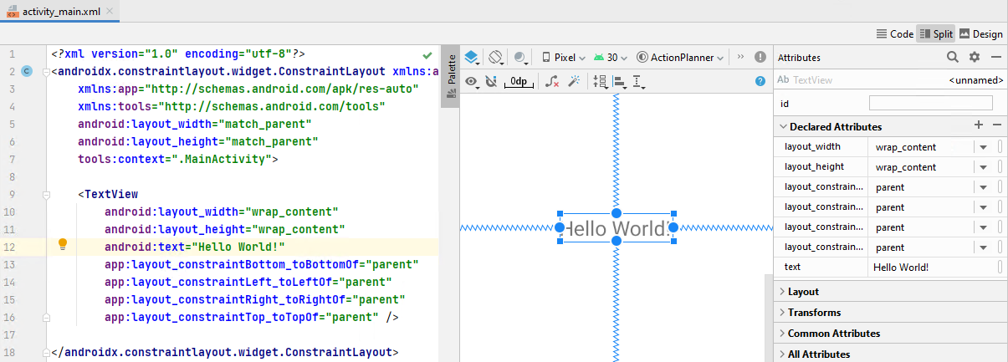
What will actually be used by a mobile device
The app user’s device will use the activity_main.xml file when building the UI.
It defines a TextView with the android:text value “Hello World”
Although you can set it by selecting the TextView and using the Attributes panel

Slide 29

So far, so good…. if your going to insist your app users can read English
What about if you want to expand into other markets?
Define a different activity_main.xml for every language?

Slide 30

String resources to the rescue
This is where string resource save you a lot of work.
All text shown in your app should be stored in res/values/strings.xml
(or alternative, like res/values-fr/strings.xml
Can provide multiple versions - one for each language, and Android will automatically select the appropriate one. See Localize your app.
Using string resources is Android best practice code style.
More details @ Android developers string resources

Slide 31
App Resources
Resources are the additional files and static content used by your app grouped by type
images,
animations,
colour definitions for reusing the same colour throughout the app,
defining menus text and icons,
text displayed on the UI

Slide 32
Why use resource rather than embed in code?
Maintainability.
It’s a lot easier to find, update, and replace resources if your searching a directory rather than through code.
Easier to provide alternatives – e.g.
one UI for portrait, one for landscape,
left to right vs right to left layouts, or
text for English and other languages
See the Android Developers Docs for more details on how resources should be organised for different types and platforms.
Its recommended coding practice and style.

Slide 33
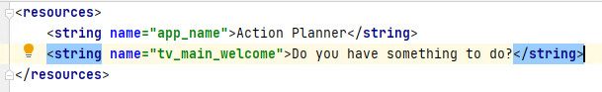
Editing your strings.xml
Double click on it from the Project panel, and it’ll open in a regular XML editor.
Add a new string resource, give it a name by which to refer to it, and a value
Here a new string with name tv_main_welcome and value “Do you have something to do?” has been added.

Slide 34
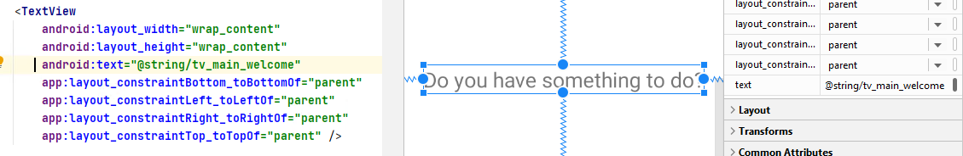
Updating the layout XML file
Change the text attribute to @string/tv_main_welcome
@string/ – indicates it a string resource being referred to
tv_main_welcome – the name of that resource.
The text on the UI now updates to the value defined in strings.xml

Slide 35
String resource format
There are some special characters which have to be handled specially in strings.xml values (e.g. @ needs to be \@, ? Needs to be \?), e.g.
(bonus points if you spotted this mistake earlier!)
You can also include some HTML markup.
And have parameterised strings that get set at runtime, e.g.
See doc’s on String Formatting for more info.

Slide 36
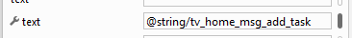
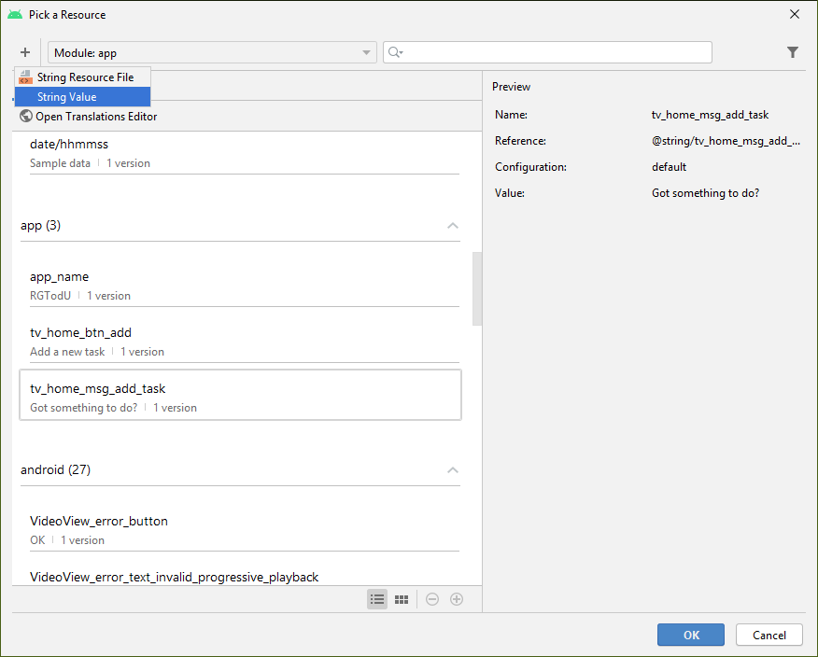
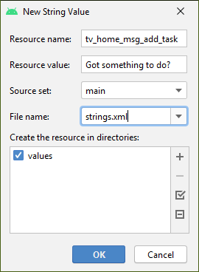
Editing XML not for you?
Click here
Then click +, then String value.
Complete the popup (just make sure its strings.xml)

Slide 37
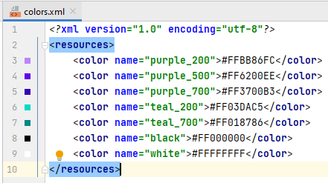
Other resources
Along with images, animations, etc. its possible to define colours in a similar way.
In res/values/colours.xml
Each colour has a name and hex code as value.

Slide 38
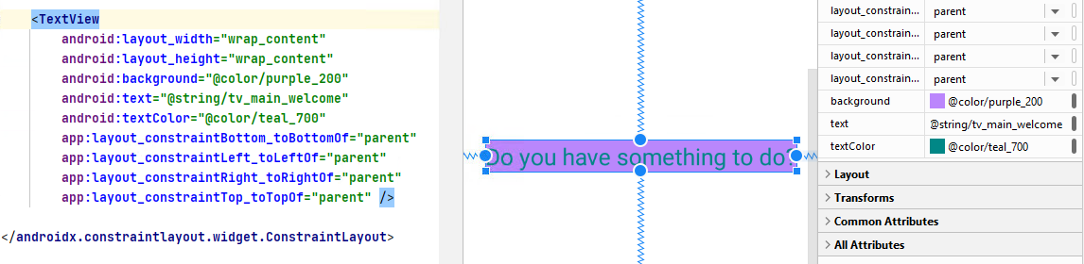
Color example
These can then be used to set colour attributes, e.g. background, textColor, ...
(find these in All Attributes)

Slide 39
Testing on Devices

Slide 40
Which device to test on?
Countless different types of Android devices, running different version of Android OS.
Owning one of each for testing your app isn’t really practical.
Even for iOS development, owning every type of iPhone + iOS version would quickly get expensive!
Virtual Devices
Xcode provides virtual iOS devices
Android provides virtual Android devices
These are also used by generic frameworks like cordova, etc.

Slide 41
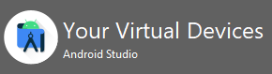
Testing on a device
If you have an Android Device, try plugging it in to the computer and you should be able to deploy to it.
Otherwise, use an Android Virtual Device (AVD). These are emulated devices, and can sometimes be a bit slow to load.
AVDs are managed by the AVD Manager (under Tools in the Android Studio menu).

Slide 42
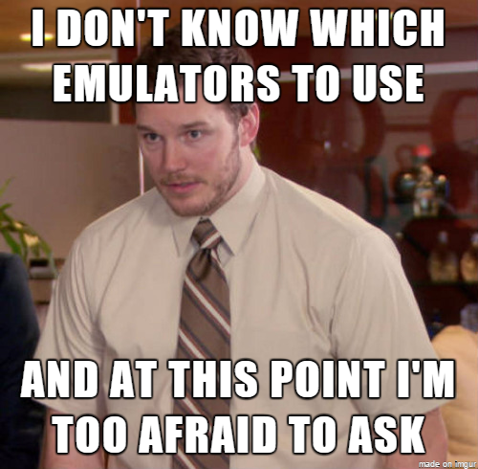
Creating an AVD using the AVD Manager
If you are using our machines, they are already setup with the Pixel 2 XL virtual device image

Slide 43
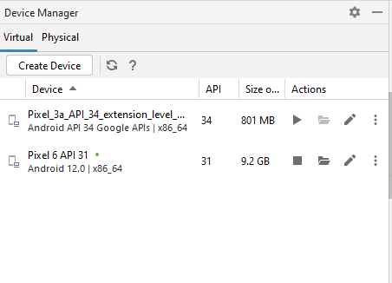
The AVD Manager
Shows details of existing AVD.
Add new AVD, by clicking

Slide 44
The most useful toolbar
Make project – i.e. force a recompile of it all.
Select the thing to run – app means your current app.
Select where its going to run – and AVD or read device (more later).
Run the app on the selected device.
Once its running on a device and changes to the code are made, update whats running on the device.
Run the app with a debugger attached.
AVD Manager (also available in Tools -> AVD Manager from the menu)
SDK Manager (also available in Tools on the menu)

Slide 45
Deploying
In the Android Studio toolbar
Will build and deploy the app (the a AVD or a connected device).
Apply changes - once the app has been deployed, this will just deploy the changes (HINT: MUCH quicker)

Slide 46
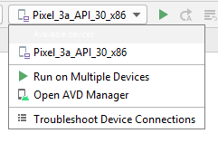
To change the deployment device
Click on the drop down arrow
Other virtual (or real) devices will be displayed.

Slide 47
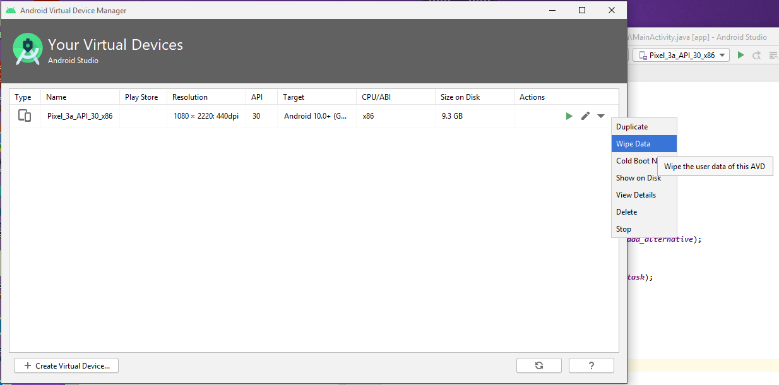
AVD slow?
Try wiping all the data (effectively a factory reset).

Slide 48
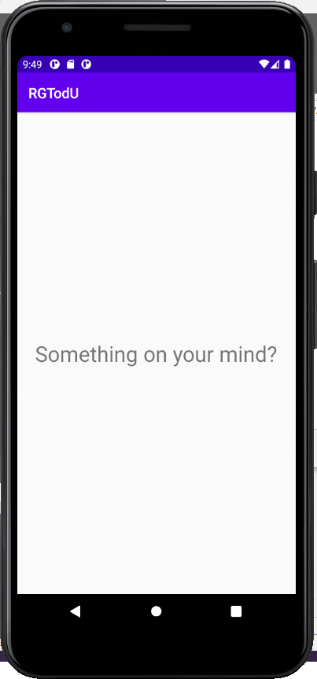

The deployed app

Slide 49
Wrap up

Slide 50
Today
Lab
Getting tools setup, starting UI design
Next week
Building user interfaces

